Slide 1
THE LIFE OF CHRIST
PART 47

Slide 2
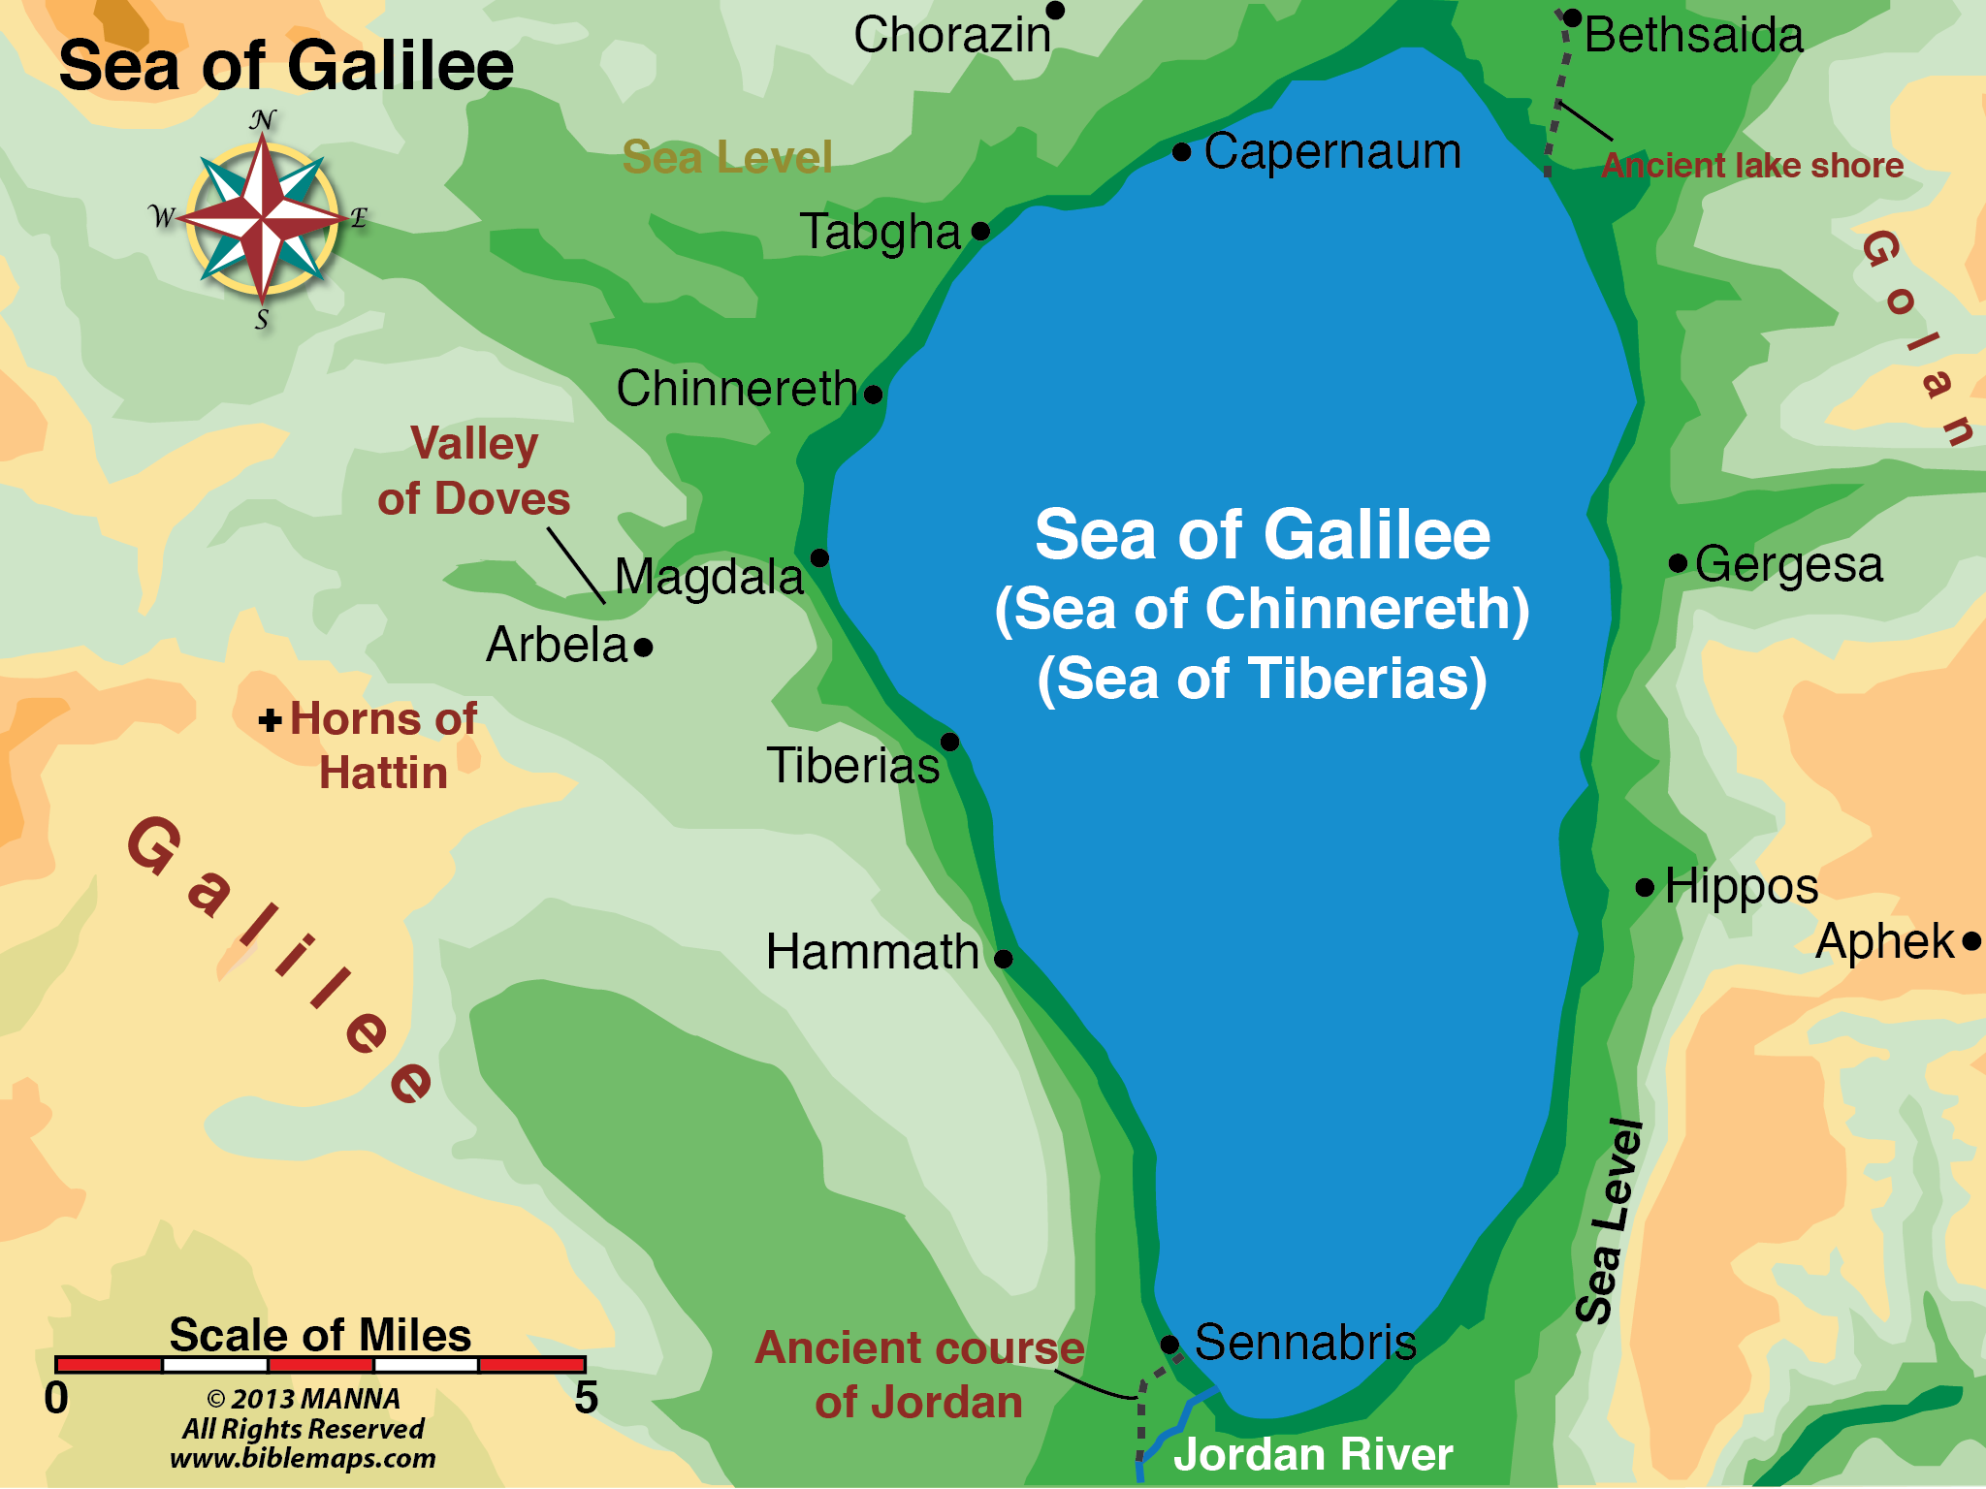

Slide 3
Matthew 16:1 Then the Pharisees and Sadducees came, and testing Him asked that He would show them a sign from heaven.

Slide 4
Mark 8:12 But He sighed deeply in His spirit.

Slide 6
² He answered and said to them, "When it is evening you say, 'It will be fair weather, for the sky is red'; ³ "and in the morning, 'It will be foul weather today, for the sky is red and threatening.' Hypocrites! You know how to discern the face of the sky, but you cannot discern the signs of the times.

Slide 7
What are "the signs of the times"? (1) The prophetic weeks of Daniel were about to expire. (2) The great herald of the new age, John the Baptist, had appeared according to prophecy, "in the spirit and power of Elijah." (3) The scepter had departed from Judah and the lawgiver from beneath his feet (Genesis 49:10). (4) Even a "sign from heaven" had already been given at the baptism of Christ when God spoke out of heaven, saying, "This is my beloved Son, in whom I am well pleased" (Matthew 3:17). (5) It had been revealed to Simeon that he should not die until he had seen the Lord's Christ; and it must be presumed that Simeon, by that time, was long since dead and buried.

Slide 8
(6) All the world was expecting the coming of some Great One. (7) The Christ himself, "that Prophet like unto Moses," had appeared upon the banks of the Jordan and had been identified by John the Baptist as "the Lamb of God that taketh away the sin of the world"! And John was the only authentic prophet Israel had had in half a millennium. Yes, it must be admitted that the Pharisees missed the signs of the times, however skilled they might have appeared as weather prophets! (Coffman Commentaries on Matthew).

Slide 9
⁴ "A wicked and adulterous generation seeks after a sign, and no sign shall be given to it except the sign of the prophet Jonah." And He left them and departed.

Slide 10
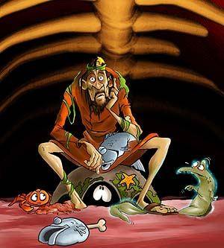

Slide 11
Mark 8:13 And He left them, and getting into the boat again, departed to the other side.

Slide 12
Matthew 16:5 Now when His disciples had come to the other side, they had forgotten to take bread. ⁶ Then Jesus said to them, "Take heed and beware of the leaven of the Pharisees and the Sadducees." ⁷ And they reasoned among themselves, saying, "It is because we have taken no bread."

Slide 14
⁸ But Jesus, being aware of it, said to them, "O you of little faith, why do you reason among yourselves because you have brought no bread? ⁹ "Do you not yet understand, or remember the five loaves of the five thousand and how many baskets you took up? ¹⁰ "Nor the seven loaves of the four thousand and how many large baskets you took up? ¹¹ "How is it you do not understand that I did not speak to you concerning bread? -- but to beware of the leaven of the Pharisees and Sadducees." ¹² Then they understood that He did not tell them to beware of the leaven of bread, but of the doctrine of the Pharisees and Sadducees.

Slide 15
They had formed a powerful, socially prominent, politically dominating alliance against him and were advocating his rejection with every cunning and lying argument possible. They argued: (1) that Christ could not be the Messiah, because Elijah had not yet come; (2) that his signs were not "from heaven," but from earth; (3) that the demons he exorcised were, in truth, cast out by the power of the devil; (4) that he was a violator of sacred traditions; (5) that he profaned the sabbath; (6) that the Scriptures "proved" the Messiah could not come from Galilee, but from Bethlehem (John 7:41); (

Slide 16
7) that none of the rulers of the people believed on him (John 7:48); (8) that they KNEW him to be a sinner (John 9:24); (9) that he was a glutton and a winebibber; (10) that he was a Samaritan; (11) that he was a friend of publicans and sinners; and (12) that he was a deceiver. (Coffman Comentary on Matthew).

Slide 17
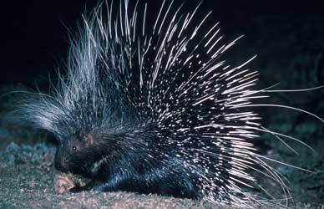

Slide 18
Mark 8:22 Then He came to Bethsaida; and they brought a blind man to Him, and begged Him to touch him. ²³ So He took the blind man by the hand and led him out of the town. And when He had spit on his eyes and put His hands on him, He asked him if he saw anything. ²⁴ And he looked up and said, "I see men like trees, walking." ²⁵ Then He put His hands on his eyes again and made him look up. And he was restored and saw everyone clearly. ²⁶ Then He sent him away to his house, saying, "Neither go into the town, nor tell anyone in the town."

Slide 20
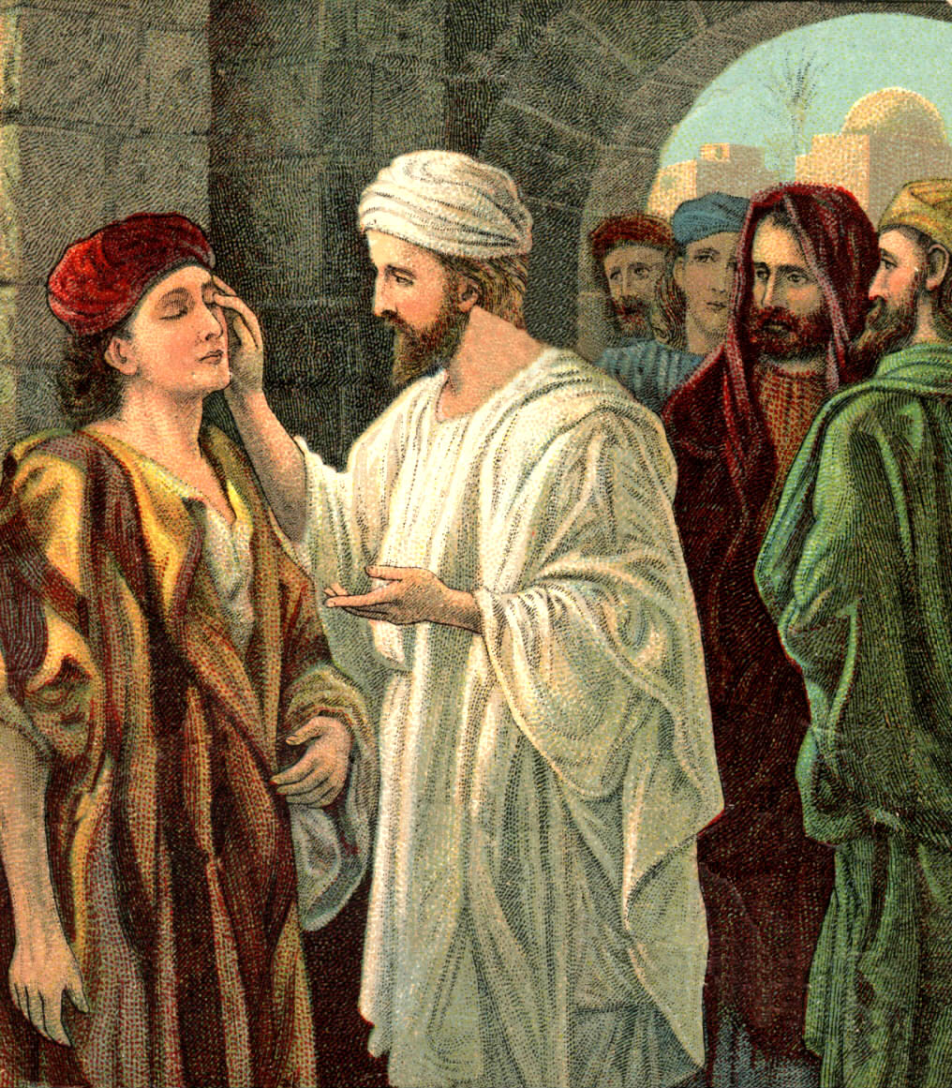

Slide 21
Mt. 16:13-20; Mk. 8:27-30; Lk. 9:18-21

Slide 22
Matthew 16:13 When Jesus came into the region of Caesarea Philippi, He asked His disciples, saying, "Who do men say that I, the Son of Man, am?"

Slide 23
Dummelow identified Caesarea Philippi as that built by Philip the Tetrarch, situated at the sources of the Jordan, near the foot of Mount Hermon (9,000 feet), in the midst of magnificent scenery. It was a Gentile city, often called Paneas (now Banias), because the god Pan was worshipped there. The other Caesarea on the sea coast, was called, for distinction, Caesarea Palestina.
(J. R. Dummelow, One Volume Commentary (New York: The Macmillan Company, 1937), p. 680.)

Slide 24
Matthew 16:14 So they said, "Some say John the Baptist, some Elijah, and others Jeremiah or one of the prophets."

Slide 25
Matthew 16:15 He said to them, "But who do you say that I am?"

Slide 26
Matthew 16:16 Simon Peter answered and said, "You are the Christ, the Son of the living God." ¹⁷ Jesus answered and said to him, "Blessed are you, Simon Bar-Jonah, for flesh and blood has not revealed this to you, but My Father who is in heaven.

Slide 27
Matthew 16:18 "And I also say to you that you are Peter, and on this rock I will build My church, and the gates of Hades shall not prevail against it. ¹⁹ "And I will give you the keys of the kingdom of heaven, and whatever you bind on earth will be bound in heaven, and whatever you loose on earth will be loosed in heaven." ²⁰ Then He commanded His disciples that they should tell no one that He was Jesus the Christ.

Slide 28
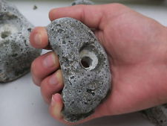
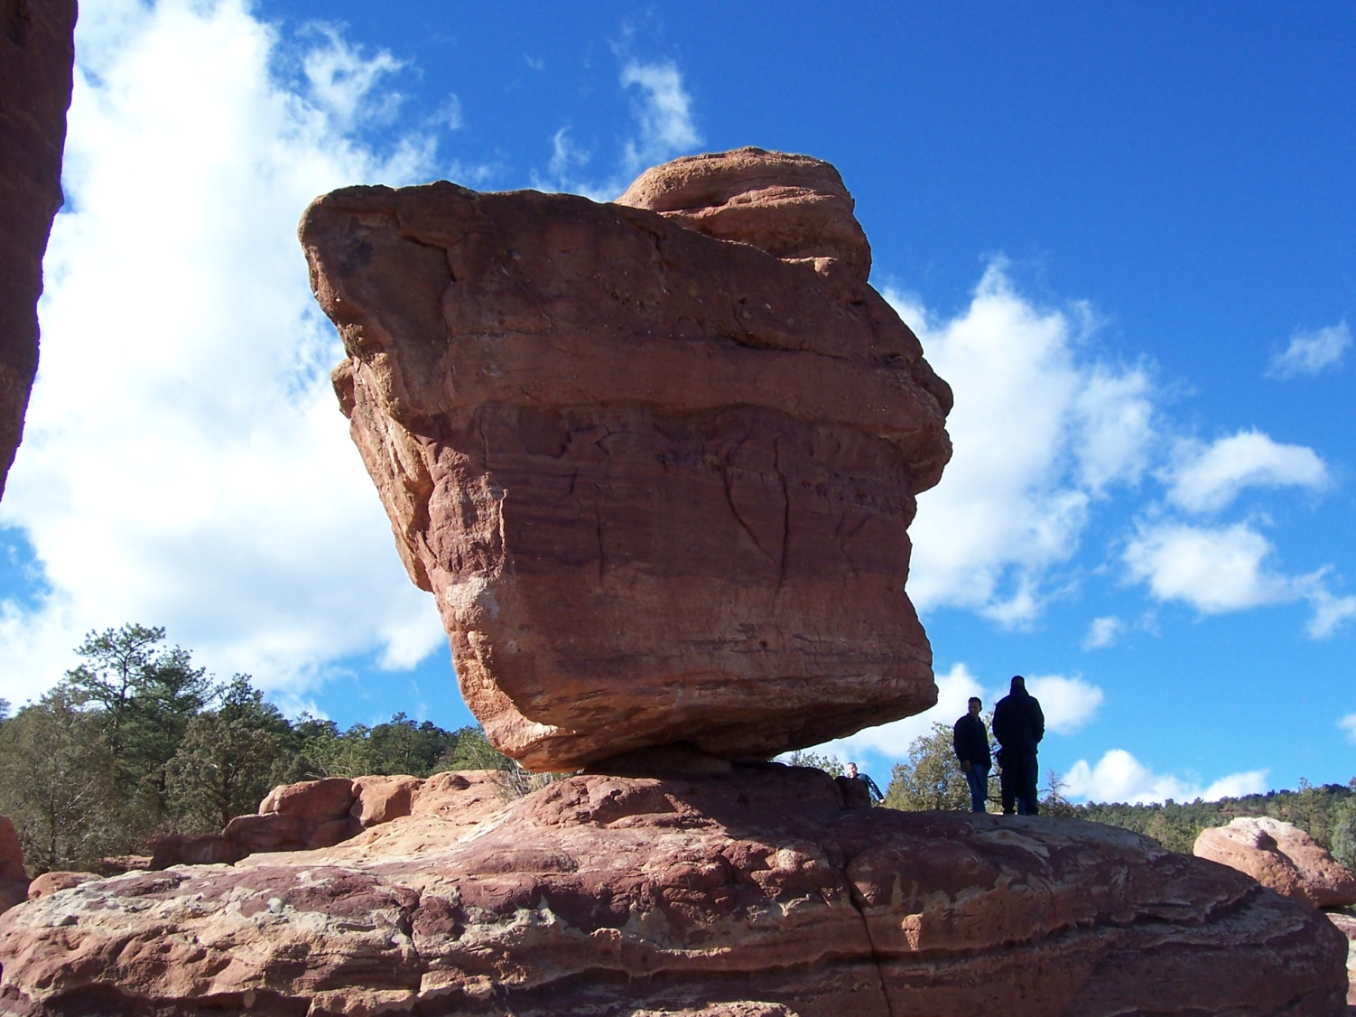
Peter – Petros (masculine form) rock or stone
Rock – Petra (feminine form) rock as in a cliff, ledge or very large stone.
Petros Petra

Slide 30
¹⁹ "And I will give you the keys of the kingdom of heaven, and whatever you bind on earth will be bound in heaven, and whatever you loose on earth will be loosed in heaven."

Slide 31
Matthew 18:18 "Assuredly, I say to you, whatever you bind on earth will be bound in heaven, and whatever you loose on earth will be loosed in heaven.

Slide 32
Matthew 16:21 From that time Jesus began to show to His disciples that He must go to Jerusalem, and suffer many things from the elders and chief priests and scribes, and be killed, and be raised the third day.

Slide 33
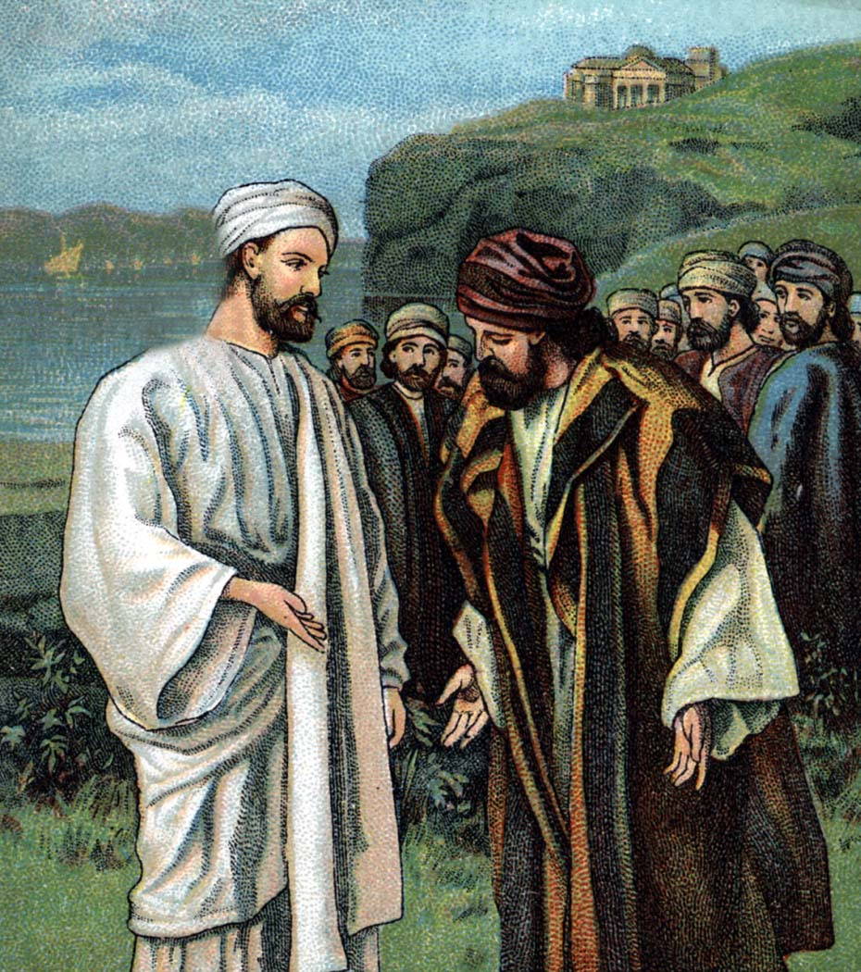
Matthew 16:22 Then Peter took Him aside and began to rebuke Him, saying, "Far be it from You, Lord; this shall not happen to You!" ²³ But He turned and said to Peter, "Get behind Me, Satan! You are an offense to Me, for you are not mindful of the things of God, but the things of men."

Slide 34
Matthew 16:24 Then Jesus said to His disciples, "If anyone desires to come after Me, let him deny himself, and take up his cross, and follow Me. ²⁵ "For whoever desires to save his life will lose it, but whoever loses his life for My sake will find it. ²⁶ "For what profit is it to a man if he gains the whole world, and loses his own soul? Or what will a man give in exchange for his soul? ²⁷ "For the Son of Man will come in the glory of His Father with His angels, and then He will reward each according to his works. ²⁸ "Assuredly, I say to you, there are some standing here who shall not taste death till they see the Son of Man coming in His kingdom."

